Slide 1
Music
Chris Hoorn, Tiffany Pohl, Cody Plungis

Slide 2
Domain Track
Required Courses:
SV 244 Music History: Medieval, Renaissance, Baroque
IA 246 Music Theory I
MUS 113 Music Skills I (Indiana State University course)
MUS 150 Introduction to Musical Traditions I (Indiana State University course)
No longer a suggested domain track
Notes:
Sources: http://www.rose-hulman.edu/Catalog1011/program-se.html
Time: 0:20
Cody

Slide 3
What is Music Software?
Music Recognition Software
Recording Software
Sampling Software
Audio Editing Software
Notation Software
DJ Software
Tuners
Notes:
Sources: http://www.music-software-reviews.com/index.html
Time: 2:00
Cody

Slide 4
Define Quality
Differs depending on the product
Usability
Efficiency
Correctness
Testability
Flexibility
Reliability
Notes:
Sources: http://www.musicmall-asia.com/minni/Papers/costam99jtlm.pdf
Time: 2:00
Cody

Slide 5
Quality Attributes
Recognition Software
Success Rate
Large Library
Recording, Writing, and Editing Software
Attractive Interface
Arrangement of menus and buttons
Representation of Music
Easy to Use
Single click actions
Helpful Labels
Large Feature List
Accurate Emulation of Music
Sound Quality
Sampling Rate
Notes:
Sources: http://www.music-software-reviews.com/index.html, ttp://www.musicmall-asia.com/minni/Papers/costam99jtlm.pdf
Time: 2:00
Cody

Slide 6
Determining Quality
Done through rigorous testing
Technical Testing
Audio Timing
MIDI Timing
Load Testing
Handling and Feature Tests
Setup
Recording
Arrangement
Automation
File Handling
Libraries
Intelligence and Ease
Notes:
Sources: http://www.music-software-reviews.com/recording_software_tests.html
Time: 3:00
Tiffany

Slide 7
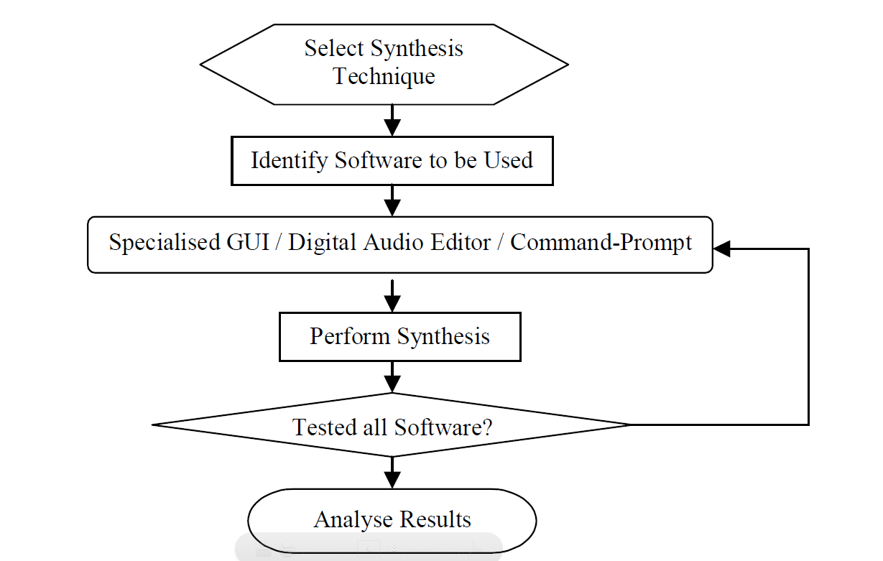
Testing Cycle
Notes:
Sources: http://www.musicmall-asia.com/minni/Papers/costam99jtlm.pdf
Time: 0:20
Tiffany

Slide 8
Metrics
Usability
Menu Levels, Shortcut Keys, and Functions
Tutorials, Help Files, and Web Support
Efficiency
Processing Time
Memory Usage
Testability
Questionnaires & Surveys
Flexibility
Customizing Parameters
Supported Formats
Reliability
Sampling Rate
Correctness
Bugs and Error Logs
Notes:
Sources: http://www.musicmall-asia.com/minni/Papers/costam99jtlm.pdf
Time: 1:00
Tiffany

Slide 9
Suggested Processes
Testing as a developer practice
Involve musicians in design process
Balance Form and Functionality
Tailor the product to the user
Notes:
Sources: Me
Time: 1:00
Tiffany

Slide 10
Suggested Metrics
Options/Menu
Features/Unit Area of GUI
Scaling Factor
Actions/Feature
Quality deterioration over number of copies/edits
Memory use per instrument or per second of data
Reliable range
Simultaneous sampling rates
Sounds/Sample
Notes:
Sources: Me
Time: 2:00
Chris

Slide 11
Industry Successes
Music Recognition Software
Shazam
Notation Software
Finale and Sibelius
Recording Software
Pro-Tools by Digidesign
Sampling Software
Gigasampler/Gigastudio
Editing Software
Sony’s Sound Forge
DJ Software
MaxVibes
Notes:
Sources: http://www.music-software-reviews.com/index.html, http://www.quora.com/Music-Recognition/What-are-the-best-music-recognition-technologies-products-or-services
Time: 1:00
Chris

Slide 12

Industry Failures
Notes:
Sources: http://www.pcworld.com/article/158300/microsoft_songsmith_bad_music_made_easy.html
Time: 2:00
Chris

Slide 13
Songsmith + Roxanne
Notes:
Sources: http://www.youtube.com/watch?v=xWYwY8GpuO0
Time: 0:30
Chris

Slide 14
Industry Standards
Audio Engineering Society (AES)
Notes:
Sources: http://www.aes.org/
Time: 1:00
Chris

Slide 15
QA Issues
Musical quality can be very subjective
Quality Assurance requires a diverse team
Quality is very dependent on hardware
Form vs. Function
Notes:
Sources: Me
Time: 1:00
Chris

Slide 16
Questions?
Notes:
Sources: Me
Time: 1:00

